Slide 1
Process Control:
Fundamentals of Process Modeling and Identification
Cai Wenjian, Contact: Tel: (65) 6790-6862, E-mail: ewjcai@ntu.edu.sg
Process Control
Dr. Cai Wenjian

Slide 2
Objectives:
Understanding of issues related Basic control algorithms, Advanced control strategies, Multivariable control, Plant parameter estimation and Process modelling and simulation.
Case studies in process control system to enhance skills and techniques for tackling practical process control system design problems.
Desired outcomes: should be able to handle tasks on modelling, analysis, design and implementation of control systems for the continuous process industry
Process Control
Dr. Cai Wenjian

Slide 3
Assessment Scheme
CA Components (20%) | Final Exam
4 x 5% (Total: 20%) | 60%
Process Control
Prof. Cai Wenjian

Slide 4
Chapter 1 Fundamentals of Process Modeling and Identification
  Introduction
  Fundamental Concepts
  Principles of Empirical Modeling
  Application in Process control
  Least Squares Methods
  Fourier Transformation
  Describing functions
  Limit cycles
Process Control
Dr. Cai Wenjian

Slide 5
Industrial Control Projects
Benefit Analysis and Functional Design: Study process unit operation practice and economics, identify process constraints, perform control benefit analysis.
Information Gathering: Identify/fix instrument problems, inspect/tune PID loops, rough estimate time constant and process gains, determine proper step sizes for identification test.
Identification: Most time consuming, traditional methods will need several weeks to perform this task.
Controller Tuning and Simulation: Tuning controller to meet unit operation requirements, checking controller nominal performance by simulation using identified model
Controller Commissioning: Load the developed controller to the control system and turned on gradually.
Controller Maintenance: If control system not perform to the specified requirement, then re-identify process model and to re-commission controller
Process Control
Dr. Cai Wenjian

Slide 6
Modeling Approaches
Rigorous (physical) modeling
derives process models using physical laws such as energy and mass balances and thermodynamics, able to describe the process behavior in a wide operation range
Process identification (Empirical Modeling)
derives process models using testing data, accurate for given working points.
 | THEORETICAL MODELING | PROCESS IDENTIFICATION
1. | Involve fewer measurements; require experimentation only for the estimation of unknown model parameters. | Requires extensive measurements, because it relies entirely on experimentation for the model development.
2. | Provides information about the internal state of the process. | Provides information only about that portion of the process which can be influenced by control action and that portion can be measured.
3. | Promotes fundamental understanding of the internal workings of the process. | Treats the process like a “black box.”
4. | Requires fairly accurate and complete process knowledge. | Requires no detailed knowledge; only that output data be obtainable in response to input changes.
5. | Not particularly useful for poorly understood and/or complex processes. | Quite often proves to be the only alternative for modeling the behavior of poorly understood and/or complex processes.
6. | Naturally produces both linear and nonlinear process models. | Requires special methods to produce nonlinear models.
Process Control
Dr. Cai Wenjian

Slide 7
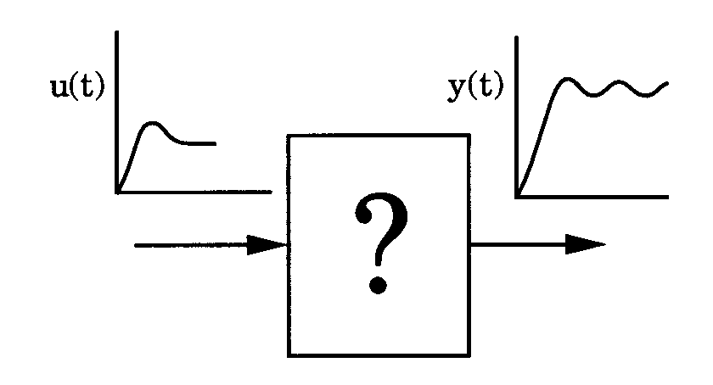
What is Process Identification?
Process identification involves constructing a process model from experimentally obtained input/output data, with no recourse to any laws concerning the fundamental nature and properties of the system.
What are the three problems in control engineering?
Process Control
Dr. Cai Wenjian

Slide 8
Application in Process Control
Multi-Linear Model: multi-linear models natural choice for controlling non-linear process units.
Dynamic Inferential Models: Product qualities are CVs, measurements are very slow. Identification based inferential models or soft sensors can be used to provide real-time prediction.
Model Reduction: Model reduction is needed to develop reduced model suitable for control. System identification can be used for model reduction of physical models
Control Performance Assessment: An automated maintenance scheme will greatly increase its efficiency. Normally, model assessment is performed using closed-loop data under control.
Process Control
Dr. Cai Wenjian

Slide 9
Definitions
Linear or Nonlinear Process Identification
  Global nonlinear
  Local linear
Off-line or On-line Identification
  Identification is done during normal process operation
  Identification is done by suspending “normal” process operation
Open-loop and Closed-loop Identification
  identify process parameter for system without control
  identify process parameter for system under control
Continuous or Discrete Model Identification
  the data regarded as sampled information from continuous signal
  the data set is taken at “face value” and utilized to identify a discrete model
Process Control
Dr. Cai Wenjian

Slide 10
Open or Closed-loop Identification
Open Loop Test: If the process behaves linearly in the operating range, low disturbance and the operation constraints are not very tight, open-loop test
Closed-loop Test: If processes suffer from high level disturbances and nonlinear in a wide range. identification better in closed-loop operation with part or all the CVs under feedback control.
Reduce the disturbance to process operation and eliminate product off- specification.
  Easy to carry out. Identification work will become easiest if the process is under feedback control.
  Better model for control. Less non-linearity, more accurate model
Process Control
Dr. Cai Wenjian

Slide 11
CT and DT Identification
Physical systems derived from physical principles are continuous in time.
Model correlated with physical properties, easy to understand physical behavior,.
No unwarranted sensitivity issues with respect to model parameters, which do in the event of discretization.
Partial knowledge is preserved in continuous-time models. If discretized, these are lost in the process of discretization.
Discretization of continuous-time models may give rise to unnatural non-minimum phase character.
If undersampled, do not converge to the original continuous-time model. The return from DT model to the original continuous-time model is not easy.
Process Control
Dr. Cai Wenjian

Slide 12
Principle of Empirical Modeling
Constructing an empirical model by process identification consists of the following stages:
  Problem Definition
  Model Formulation
  Parameter Estimation
  Model Validation
Process Control
Dr. Cai Wenjian

Slide 13
Problem Definition
Impossible to represent all aspect of the physical process,
  capture those aspects that most relevant to the problem at hand.
A process can be interpreted in different ways, resulting different models
  same aspect but various angles, vary degree of complexity.
A process model is only useful with tool available for solution
  some modeling solved analytically, others by numerical methods
Ask yourself before modeling:
What do we intend to use the model for?
How simple or complex, will the model have to be?
Which aspects of the process most relevant and be contained in model?
How much fundamental of the process operation known?
How can we test the adequacy of the model?
How much time do we have for the modeling exercise?
Process Control
Dr. Cai Wenjian

Slide 14
Model Formulation
Analysis of input/output data to detect model form capable of explaining the observed behavior
First order Plus Time Delay
Second order Plus Time Delay
Process data files: Collect as much data in the proper range of operating conditions — necessary to “identify” aspects considered important.
Example:
To identify properly the steady-state gain of a process from step-response data, it is advantageous to collect data until the process is well established at the new steady state.
If the data collection is stopped before the new steady state is achieved, the steady-state gain will be difficult to identify accurately.
Process Control
Dr. Cai Wenjian

Slide 15
Input function Selection
Useful process information of output data dependent on input function.
Using input function providing output rich in useful process information and easily extracted.
The typical input functions used in process identification are:
  Step#
  Impulse#
  Pulse (rectangular or arbitrary)#
  Sine waves#
  Relay#
  White noise
  Pseudo random binary sequences
Process Control
Dr. Cai Wenjian

Slide 16
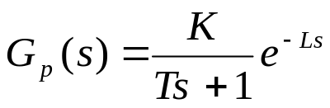
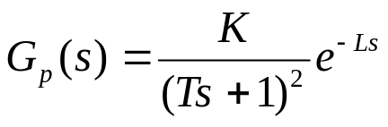
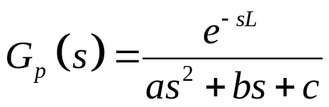
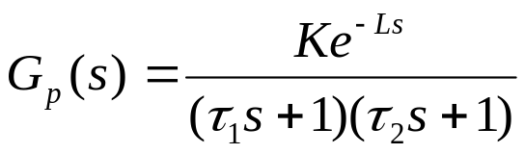
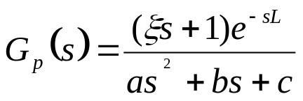
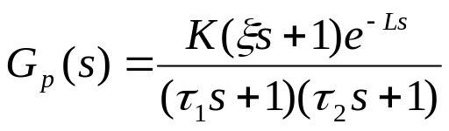
Process Dynamics
For most processes, typical “continuous-­time” candidate models:
Three parameter model
Four parameter model
Five parameter model
Process Control
Dr. Cai Wenjian

Slide 17
Parameter Estimation
After candidate model selected, estimate unknown parameters.
  Fitting the experimental data to a predetermined model form by finding parameter values which provide the “best” fit.
  Estimating unknown parameters carried in the time domain, or in the frequency domain.
Process Control
Dr. Cai Wenjian

Slide 18
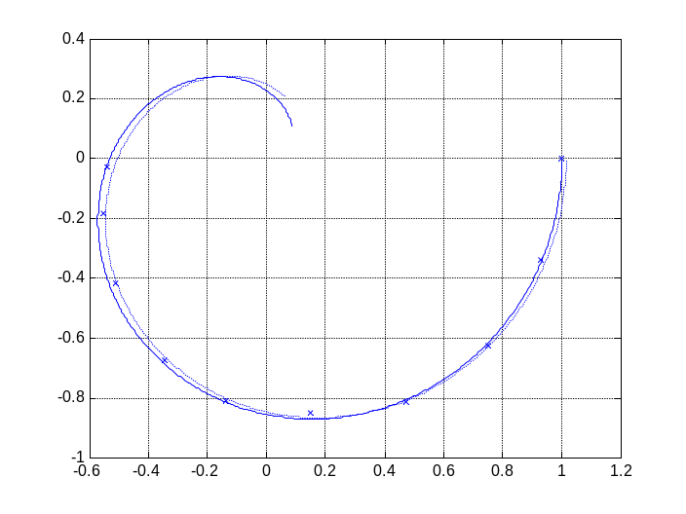
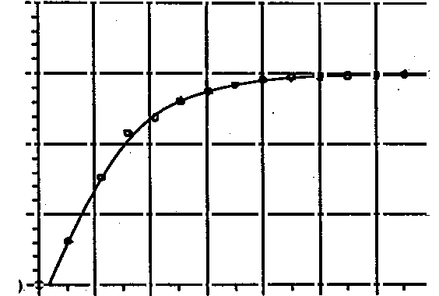
Model Validation
Final step involves checking how the empirical model fits the data it is supposed to represent.
  Comparing model predictions with additional process data, and evaluating the fit.
  Time domain, response to certain signal
  Frequency domain, Nyquist Plot.
Process Control
Dr. Cai Wenjian

Slide 19
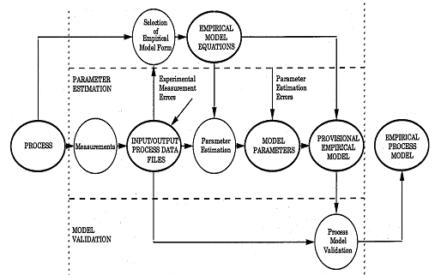
Flow Chart of Process Identification
Process Control
Dr. Cai Wenjian

Slide 20
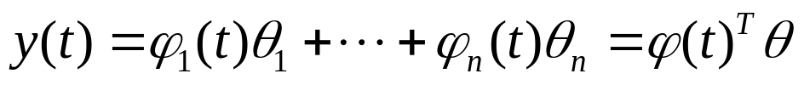

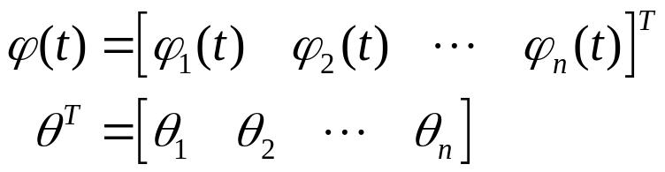
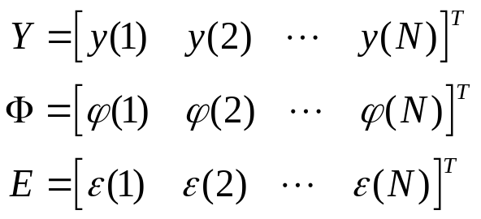

Least Squares Formulation
Regression model:
Define
N measurements {y(t)}, φ(t)} available
Define error
Process Control
Dr. Cai Wenjian

Slide 21
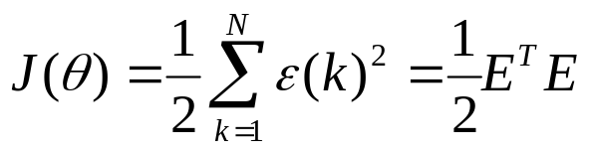
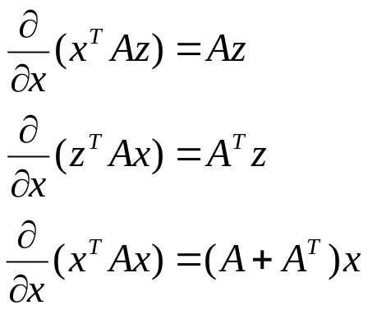
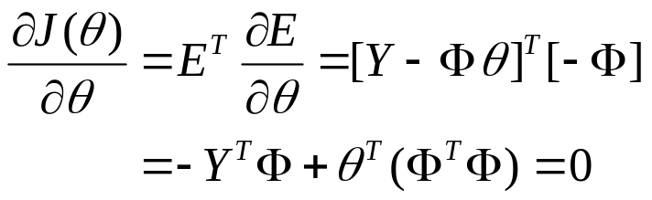

Least Squares Methods
The least squares estimate of is the vector which minimises:
The least‑squares estimate of θ, can be found by minimizing J(θ).
matrix is nonsingular the solution is given by
Process Control
Dr. Cai Wenjian

Slide 22
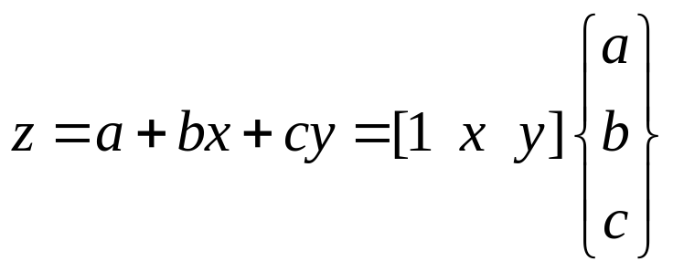
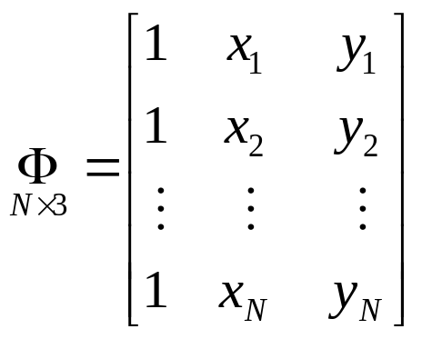
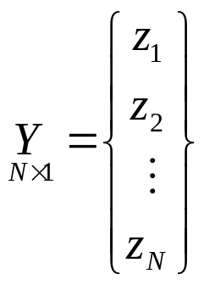
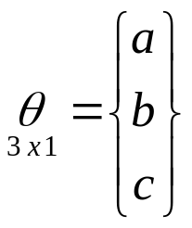
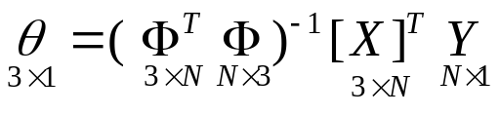
Example: Plane
A linear planar model
N measurements {z, x, y}
The Least Squares Estimation is
Process Control
Dr. Cai Wenjian

Slide 23

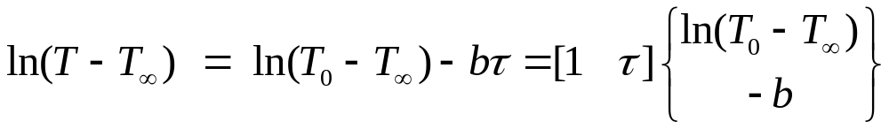
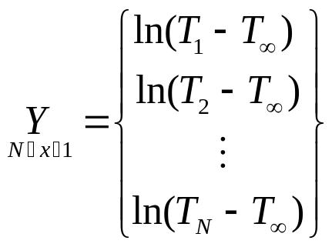
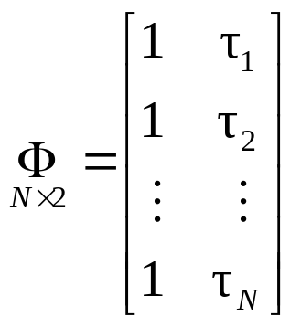
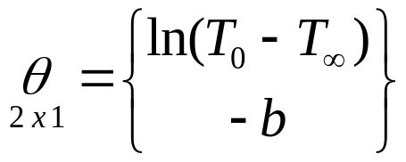
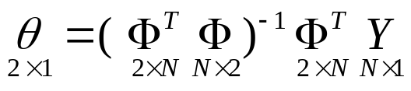
Example Newtonian Cooling
the temperature T is function of T₀ and T∞
Taking the logarithm after a simple algebraic rearrangement
Process Control
Dr. Cai Wenjian

Slide 24
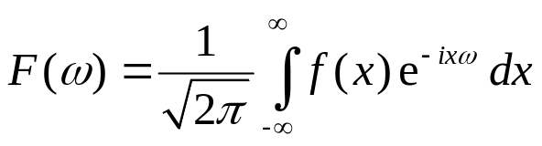
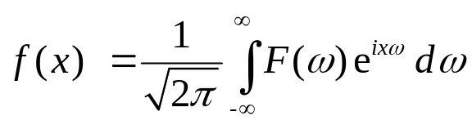
Fourier Transforms
Fourier transforms: important tool in solving problems in engineering.
alter a problem into one that can be more easily solved.
The Fourier transform of f(x) is defined as
Applying the same transform to F(s) gives
Process Control
Dr. Cai Wenjian

Slide 25

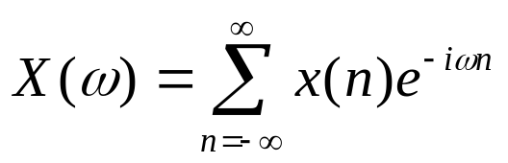


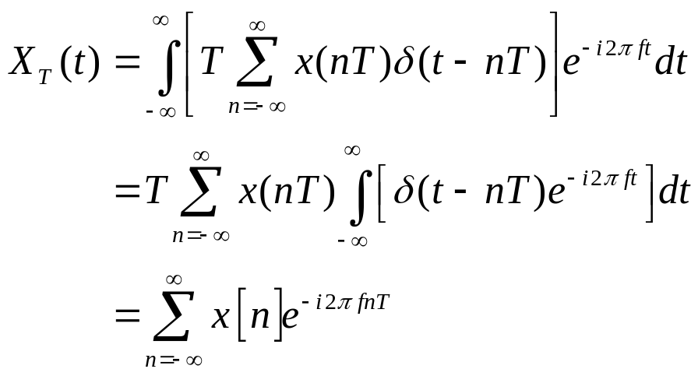
Discrete Fourier Transform (DFT)
Given a discrete set of real or complex numbers:
DFT of
Approximate
Process Control
Dr. Cai Wenjian

Slide 26
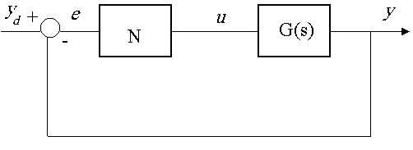
Describing functions
The Describing Function describes nonlinearities by split the system to
    a nonlinear element
    followed by a linear system
    sinusoidal inputs to the NL
The output of the nonlinearity, u, is not sinusoidal
Fourier series approximation:
    Output: a fundamental frequency plus harmonics.
DF: amplitude ratio of fundamental component of u to input e. it may be
complex (ie phase shift)
e magnitude dependant
Process Control
Dr. Cai Wenjian

Slide 27
Limitations and Assumptions
limitations
Only a single nonlinearity can be considered
The NL cannot vary with time.
assumptions
nonlinearity is not ‘too’ severe (difficult to judge)
a linear part of plant works as a LPF
The assumption 2 reasonable since all real systems possess cannot respond to infinitely high frequencies
Process Control
Dr. Cai Wenjian

Slide 28

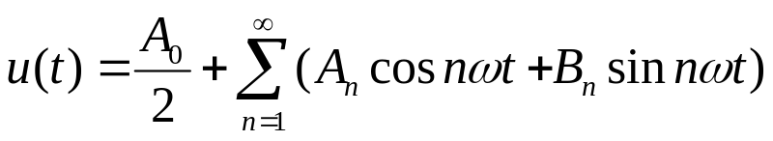
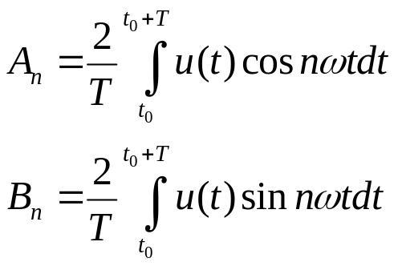


Describing Function Evaluation
NL input
NL output by its Fourier series representation
By assumptions:
NL element is an odd function
a linear part of plant works as a LPF, filter out high harmonics
Process Control
Dr. Cai Wenjian

Slide 29
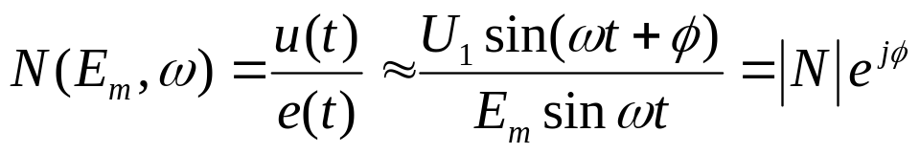
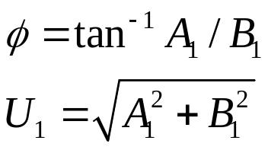
Describing Function Evaluation
Describing function is input over NL element (similar to transfer function)
Process Control
Dr. Cai Wenjian

Slide 30


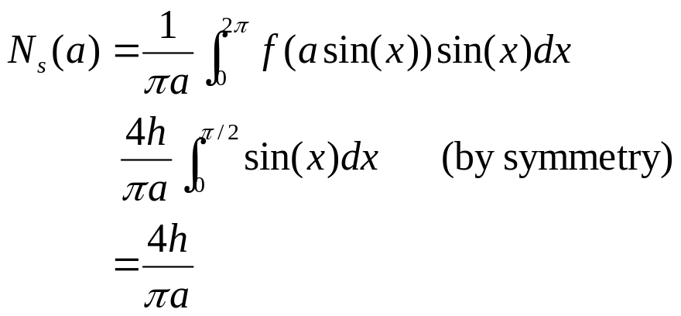

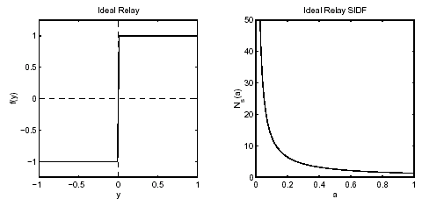
Ideal relay
u(t): odd-symmetric function (i.e., N(a) is un­biased and symmetric to the origin), the coefficients A₀ and A_{n} are equal to zero.
Process Control
Dr. Cai Wenjian

Slide 31


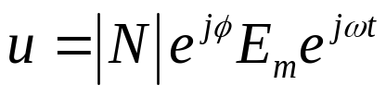
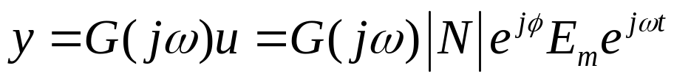

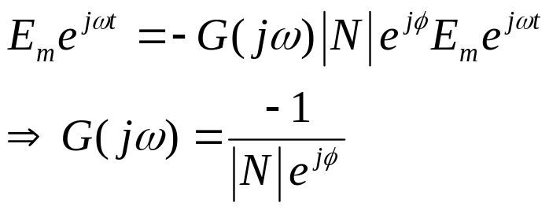
Limit Cycles
Assuming input to nonlinearity is sinusoidal
the nonlinearity at given input conditions is
the output of the nonlinearity is
output of the linear system is
Following the feedback loop around
have sustained oscillations if
Process Control
Dr. Cai Wenjian

Slide 32



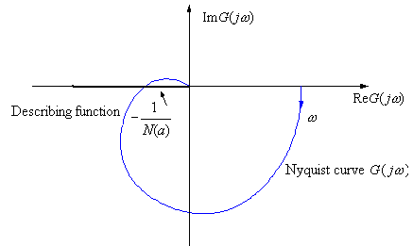
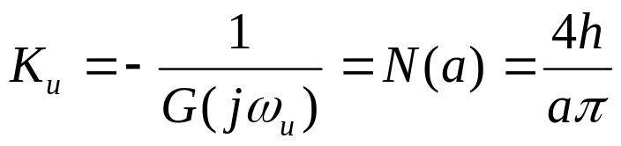
Limit cycle analysis
Assume N is purely a gain term
Stability condition
Nyquist plot
Process Control
Dr. Cai Wenjian

